Slide 1
Row Level Security
configuration
Row Level Security
configuration

Slide 2
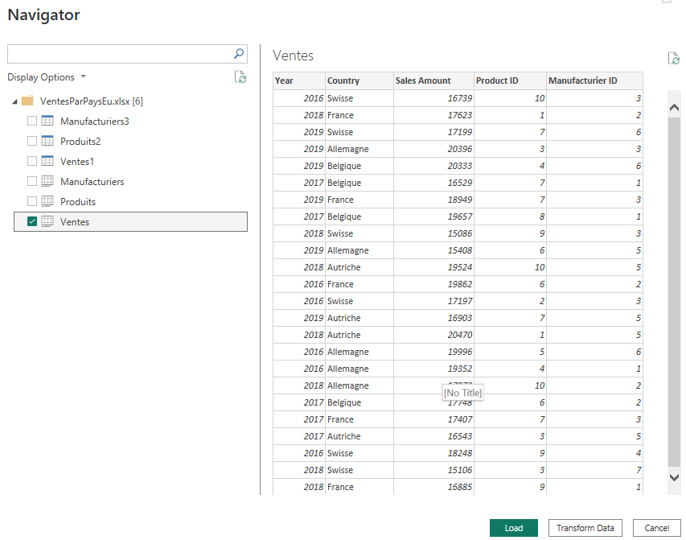
Configuring the Row Level Security
Note: This lab requires a Power BI Services account with administrator privileges and the file VenteParPaysEu.xlsx in the Excel Files Folder
Start by loading the Sales table

Slide 3
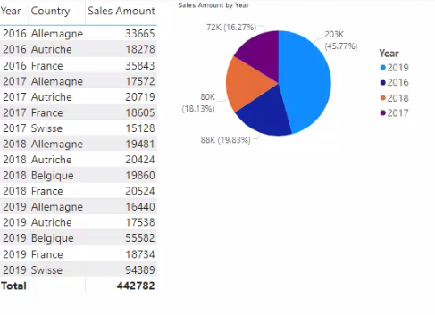
Configuring the Row Level Security
Add visuals at the report level and create simple report

Slide 4
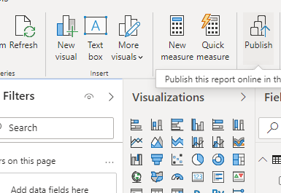
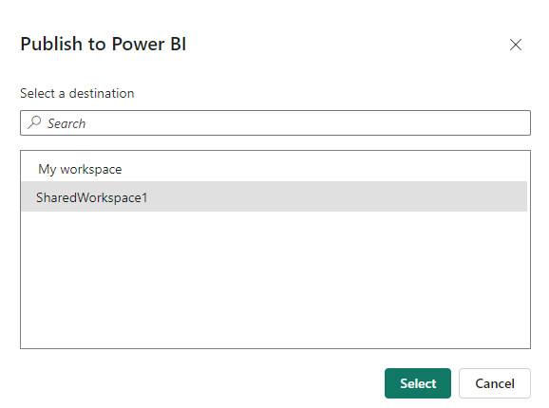
Configuring the Row Level Security
Publish the report to Power BI Service by clicking Publish at the top right
Publish the report to Power BI Service to one of the reports

Slide 5
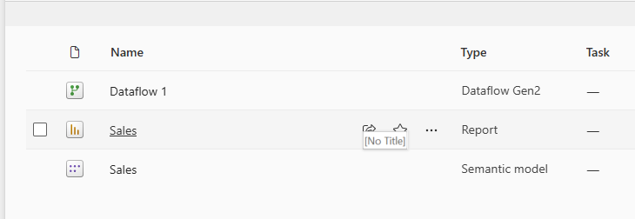
Configuring the Row Level Security
Verify that the data is fully visualized without exception at Power BI Service level by clicking Sales link

Slide 6
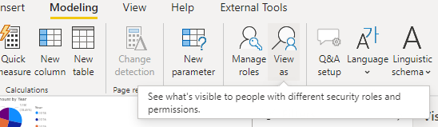
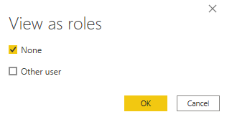
Configuring the Row Level Security
Go back to Power BI Desktop and click View as Roles on the Modeling tab
Check that no roles are configured now

Slide 7
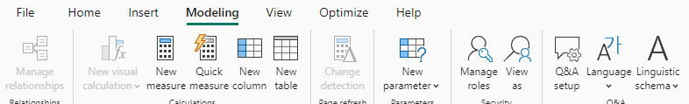
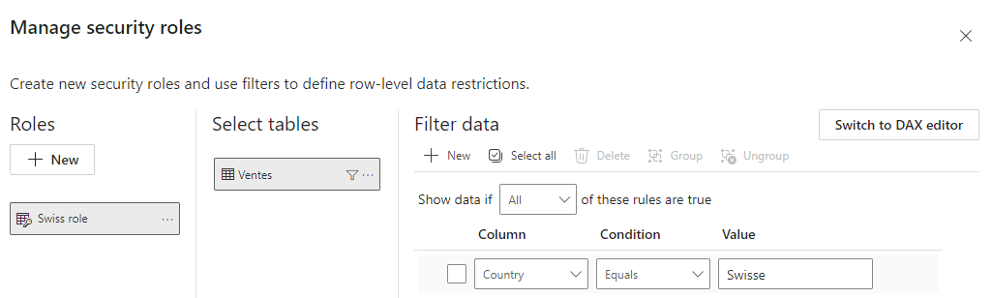
Configuring the Row Level Security
Select Management roles under Modeling tab
Configure a Swiss role on the table to see only data related to the Swiss country
2
1
3

Slide 8
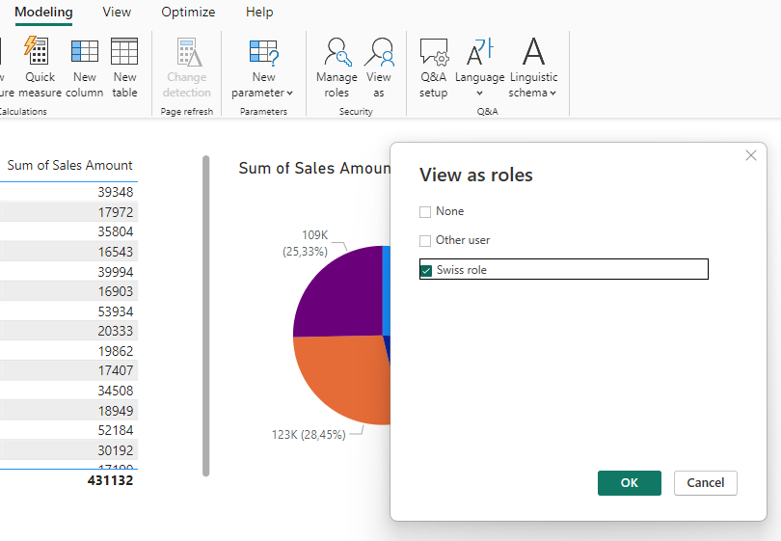
Configuring the Row Level Security
Return to menu View as roles and notice that the new role has just been added, select the new role and then click OK

Slide 9
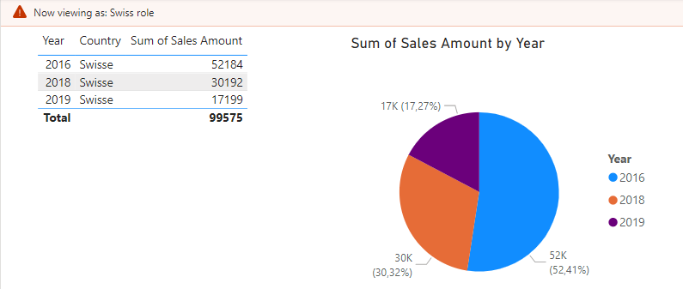
Configuring the Row Level Security
Note that only data related to Swisse is shown in the report

Slide 10
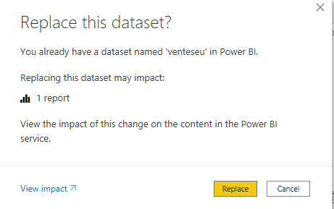
Configuring the Row Level Security
Restart report publication with Swiss role configured , replace DataSet during publication

Slide 11
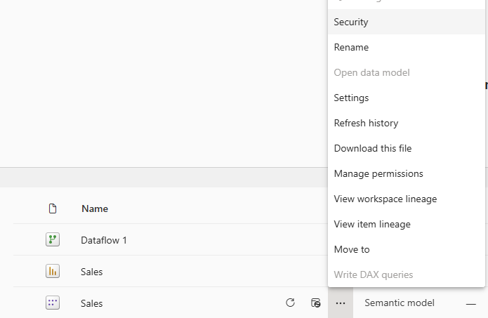
Configuring the Row Level Security
Click the three dots next to the DataSet item in the workspace under Power BI Services and select Security

Slide 12
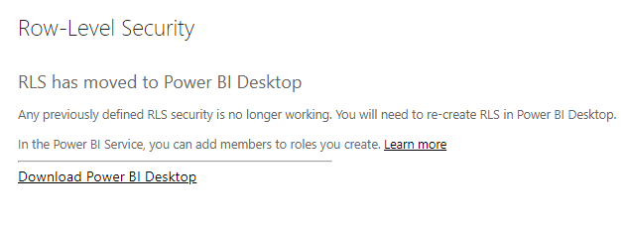
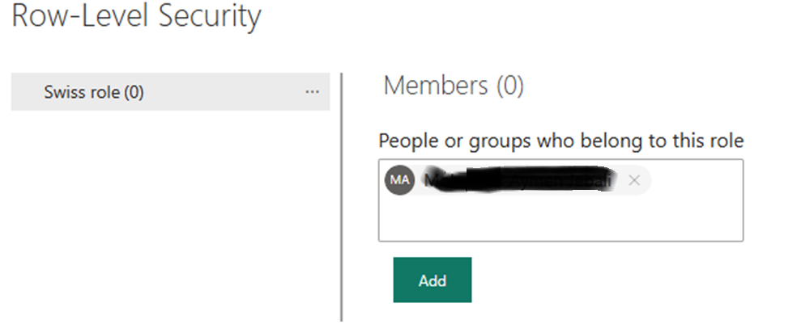
Configuring the Row Level Security
Note that in case no RLS configuration is made the interface is
Note that after RLS configuration the interface changes, map the Swiss role to one of the users' emails

Slide 13
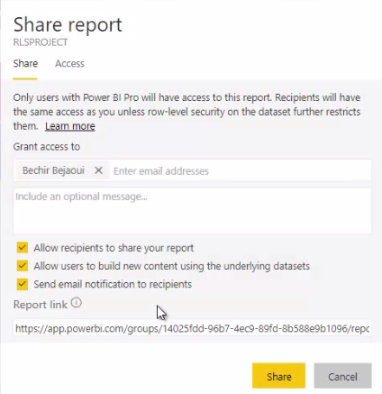
Configuring the Row Level Security
Share the report with that user then log in with the user in question in a browser in private mode to test
the RLS-based filter

Slide 14
Thank you
Thank you

